Slide 1

Stress Detection in Students using Machine Learning
by
K.R Tharun
Roll No. 214G1A32B3
B.Purushotham
Roll No. 214G1A3281
C.Sai Priya
Roll No. 214G1A3291
C.Neha
Roll No. 214G1A3268
Under the guidance of
Dr.P.Chitralingappa M.Tech.,Ph.D.
Associate Professor & Head Dept. of CSE(Data Science)
GitHub Link: https://github.com/SaiPriya2004/CSD-2024-2025-Batch-B-03
Department of Computer Science and Engineering
Srinivasa Ramanujan Institute of Technology
(Affiliated to JNTUA & Approved by AICTE) (Accredited by NAAC with ‘A’ Grade & Accredited by NBA (EEE, ECE & CSE)
Rotarypuram Village, B K Samudram Mandal, Ananthapuramu – 515701.
2023 - 2024

Slide 2
Abstract
This project focuses on developing an intelligent system to classify emotion-based stress levels and detect stress using both image data and physiological features. The system utilizes an image dataset to analyze facial expressions for emotion-based stress classification, leveraging a Convolutional Neural Network (CNN) to detect emotions such as happiness, sadness, anger, and surprise. Additionally, the system detects stress levels through a CSV file dataset containing physiological features, including body temperature, hours of sleep, heart rate, snoring range, and respiration rate.
For live stress classification, the system employs OpenCV to capture real-time video from the user's webcam, process facial expressions, and calculate a stress percentage. The backend is powered by Flask, integrating the machine learning models with an intuitive frontend for seamless real-time interaction. This approach combines visual cues and physiological data to accurately assess and monitor stress levels, offering applications in health monitoring, personal well-being, and stress management.
Keywords: emotion recognition, Convolutional Neural Network (CNN), DeepFace, Flask, facial features, machine learning, computer vision.

Slide 3

Contents
Introduction
Literature Survey
Existing System
Proposed System
Objectives
Requirements (functional and nonfunctional)
System Architecture
Data Flow Diagram / UML / ER
Implementation
Results (Screenshots)
Conclusion
References
Paper submission proof

Slide 4
Introduction
Stress is a major issue nowadays, especially among youngsters. But too much stress for a long time can harm our mind and body. It can lead to problems like depression, suicide, heart attacks, and stroke. That’s why it is important to detect stress early to stay healthy.
Common ways to check stress, like surveys or medical tests, do not always give quick results or notice small changes in stress levels.
By using advanced technology like Machine Learning led to innovative approaches for stress detection, including emotion recognition from facial expressions and monitoring physiological signals.
One method is studying facial expressions to recognize emotions. Since our face shows how we feel, it can help understand stress levels.
Another method is checking body signals like heart rate, breathing, body temperature, and sleep patterns. These signals show how the body reacts to stress.
By using both facial expressions and body signals together, we can create a more accurate and effective system to detect stress.

Slide 5
Literature Survey
S.NO | JOURNAL | AUTHOR | TITLE | OUTCOME
1. | 9th International Conference for Convergence in Technology,(I2CT) 2024 | Ashutosh Singh, Khushdeep Singh, Amit Kumar | Machine Learning Algorithms for detecting Mental Stress in College Students | The study highlights the highest accuracy in stress classification reaching 95% using machine learning models
2. | Published by Elsevier Ltd | Ravinder Ahuja, Alisha Banga | Mental Stress detection in University Students using Machine Learning Algorithms | The paper concludes that the SVM algorithm outperforms other classification methods in assessing stress levels using the Perceived Stress Scale (PSS), with potential to improve mental health through more accurate methods
3. | International Journal of Research Publication and Reviews | Ms. Ancy Paul, Ms. Resija | Stress Detection in College Students Using Machine Learning Algorithm | The paper presents a machine learning model that classifies college students' mental stress levels with 99% accuracy using Random Forest, and suggests applying the model to other groups while exploring real-time stress detection via images, videos, wearable sensors, and social media posts.

Slide 6
Existing System
Traditional ways of detecting stress mostly depend on personal reports, questionnaires, and manual checks. People often answer surveys like the Perceived Stress Scale (PSS) or take part in interviews. A doctor or therapist then reviews their answers to understand their stress levels.
In some cases, medical tests are also used. These tests check things like cortisol levels (a stress-related hormone) or heart rate changes to see how the body reacts to stress.

Slide 7
Proposed System
This system leverages advanced machine learning models, such as Convolutional Neural Networks (CNNs), to analyze facial expressions and detect emotional states, which are strongly linked to stress.
The system applies text classification to analyze a CSV file dataset containing important physiological features, such as body temperature, hours of sleep, heart rate, snoring range, and respiration rate.It classifies and predicts stress levels based on these dataset feature
The system uses image classification to detect and classify human emotions such as happy, sad, and disgusted based on facial expressions.
The system uses live classification to detect stress in real time through a webcam.
By combining these factors, the system can better detect stress levels.

Slide 8
Objectives
Develop a Machine Learning model to detect stress levels based on collected data.
To build a model for emotion recognition from facial expressions, including emotions such as happiness, sadness, anger, and surprise.
To design and implement a stress level prediction model based on physiological features such as snoring range, respiration rate, body temperature, hours of sleep, and heart rate.
To integrate emotion detection and stress level prediction into a unified system, processing real-time input from a webcam.

Slide 9
Requirements (functional and nonfunctional)
Functional Requirements:
Real-Time Facial Emotion Detection: The system should analyze facial expressions using a webcam to detect emotions (e.g., happy, sad, angry, surprised).
Physiological Data Processing: The system should collect and analyze physiological data such as Heart rate, Respiration rate,Snoring range,Body temperature,hours of sleep.
Stress Level Classification: The system should classify stress levels into 0-5 categories based on physiological data.
Recommendations & Solutions: Provide stress management techniques, relaxation exercises, and mental health resources based on detected stress levels.
Non-Functional Requirements :
Performance: The system should process real-time data efficiently without significant delays
Reliability: Ensure accurate detection of stress levels with minimal errors.
Portability: Should be compatible across different devices, including mobile phones, tablets, and desktops.

Slide 10
System Architecture
The system architecture for consists of multiple components to capture, process, analyze, and predict stress levels based on facial expressions and physiological data.
Input Layer
Webcam – Captures real-time facial expressions.
Physiological Data – Measures parameters like heart rate, respiration, and sleep patterns.
User Input (Optional) – Self-reported stress levels or behavioral surveys
Preprocessing Layer
Face Detection (Using OpenCV)
Detects and extracts facial regions from the video feed.
Ensures proper alignment for Stress level.
Image Enhancement
Converts images to grayscale.
Applies noise reduction and normalization.
Feature Extraction (DeepFace Library)
Identifies facial landmarks.
Recognizes emotional expressions like happiness, sadness, anger, and surprise.

Slide 11
Cont..
Machine Learning Model Layer
Emotion Recognition Model (DeepFace, CNN)
Classifies facial expressions into emotional categories.
Stress Prediction Model (Deep Learning)
Uses facial expressions and physiological data to classify stress levels into low, moderate, or high.
Integration of Physiological Features Processes data from sensors (heart rate, oxygen level, sleep patterns) to enhance prediction accuracy.
Output Layer
Real-time Stress Prediction
Displays the detected stress level .
Recommendations
Suggests stress management techniques based on detected levels.

Slide 12
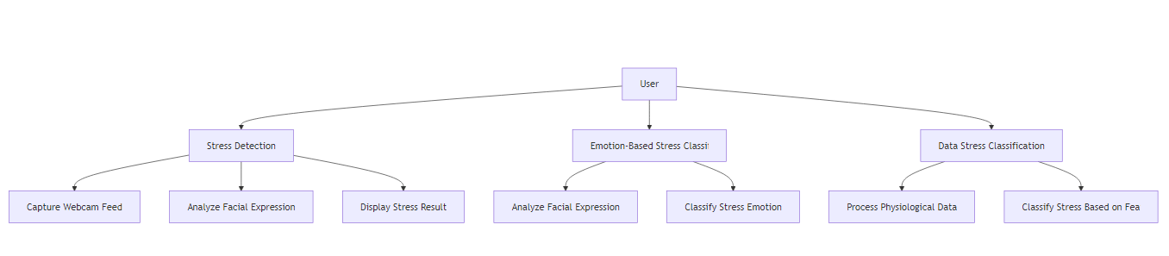
Data Flow Diagram / UML / ER
A use case diagram in the Unified Modeling Language (UML) is a type of behavioral diagram defined by and created from a Use-case analysis.
Its purpose is to present a graphical overview of the functionality provided by a system in terms of actors, their goals (represented as use cases), and any dependencies between those use cases.

Slide 13
Implementation
Convolutional Neural Network (CNN)
A Convolutional Neural Network (CNN) is a deep learning model primarily used for image classification and recognition tasks. It consists of several layers, including:
Convolutional layers: These layers apply filters to the input image, extracting features like edges, textures, and patterns.
Pooling layers: These layers reduce the dimensionality of the image, preserving important features and reducing computational complexity.
Fully connected layers: After feature extraction, the CNN uses these layers to classify the image based on the learned features.
Output Layer: This layer is responsible to produce the final output.

Slide 14
Cont..
Model Integration: This module integrates the emotion detection (CNN), and (DeepFace) models. It manages the flow of data between the models and ensures accurate predictions based on the live feed from the webcam.
Flask Web Application: The system is hosted on a Flask-based web application. This module ensures that the backend handles requests like opening the webcam, processing the images, and serving the predictions to the frontend. It provides routes for different pages, like the homepage and prediction page.
DeepFace Library: Performs facial emotion recognition using deep learning.
Emotion Recognition – Classifies emotions (happy, sad, angry, surprised, neutral).
Deep Learning Models – Uses advanced models like VGG-Face, FaceNet, ArcFace, DeepID.
Real-Time Prediction – Works on live webcam feeds to assess emotional state.
Opencv Library:Handles real-time face detection and image processing.
Face Detection – Detects and tracks a student’s face from a webcam feed.
Video Stream Processing – Captures real-time frames for continuous stress monitoring.
Preprocessing – Enhances image quality (grayscale conversion, noise reduction).
Facial Feature Extraction – Identifies key facial landmarks for further analysis.

Slide 15
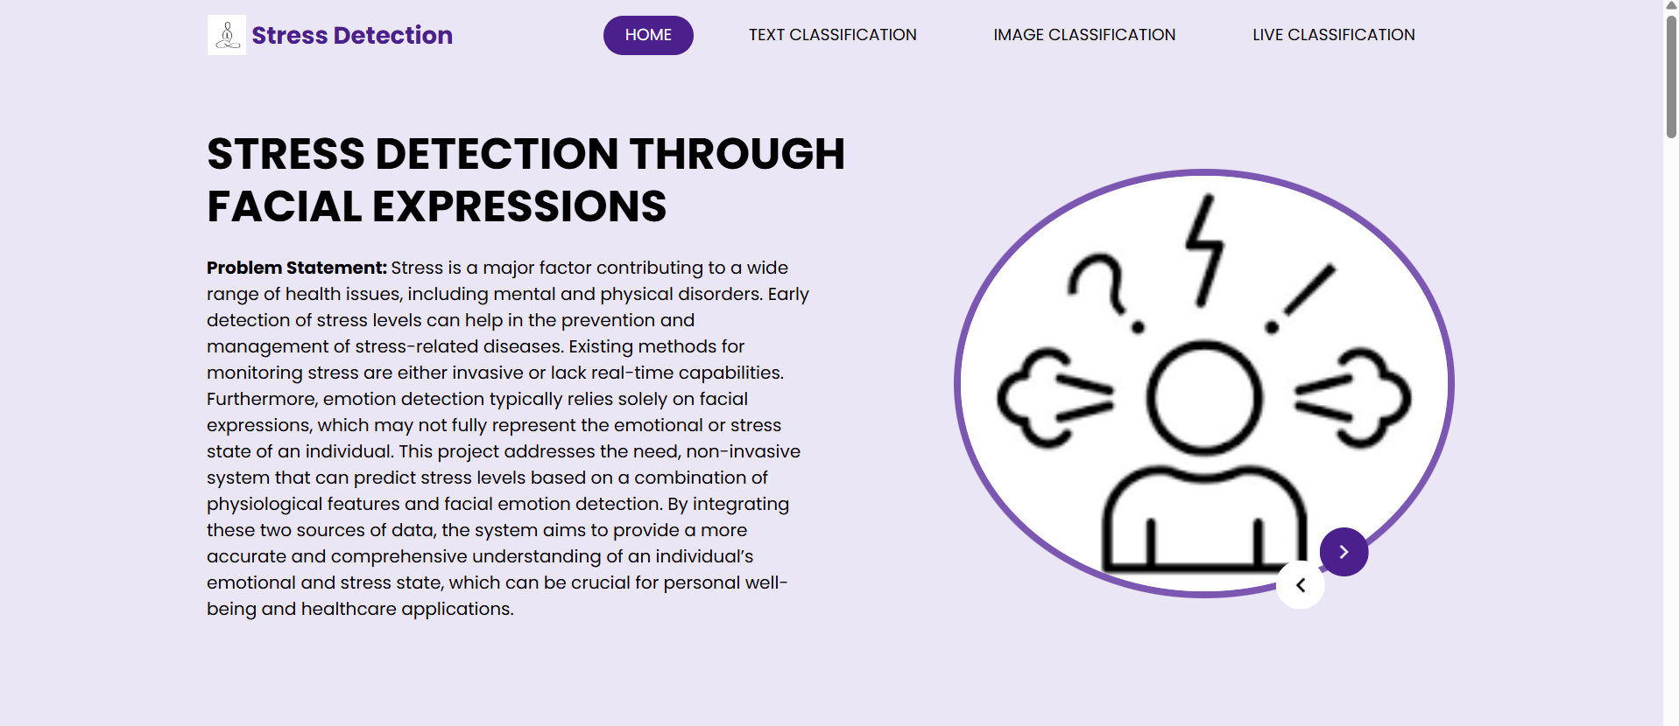
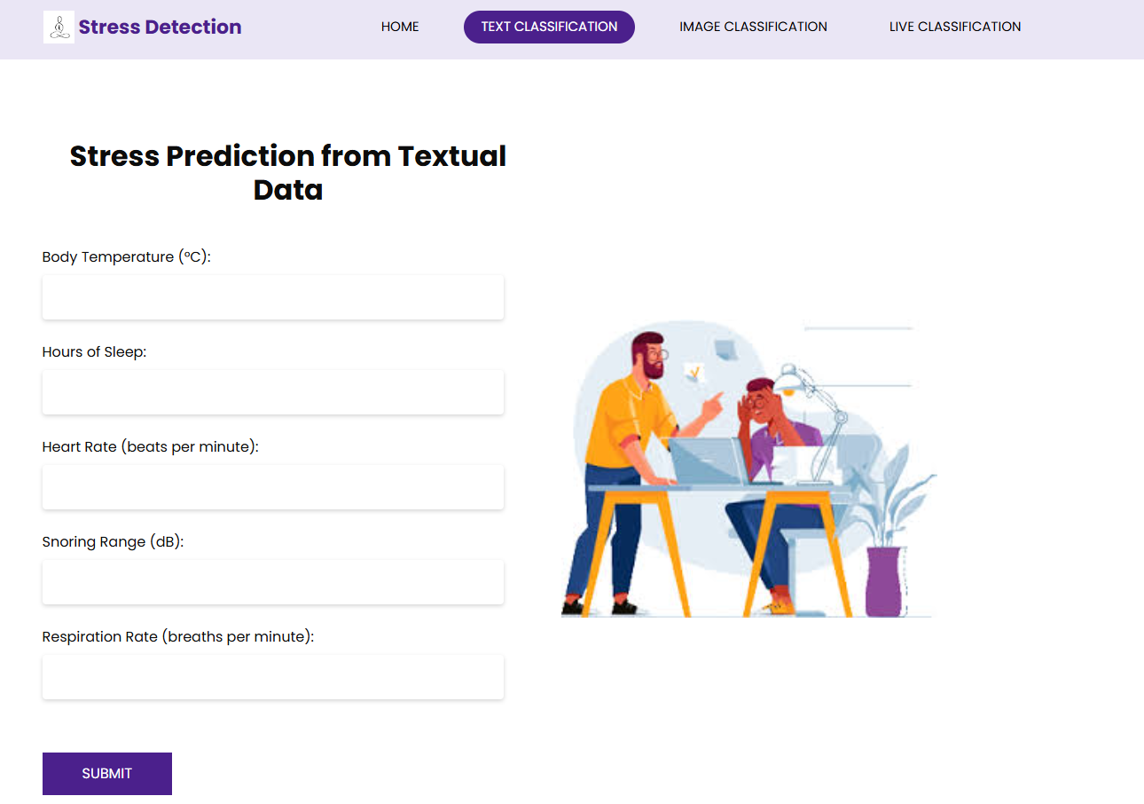
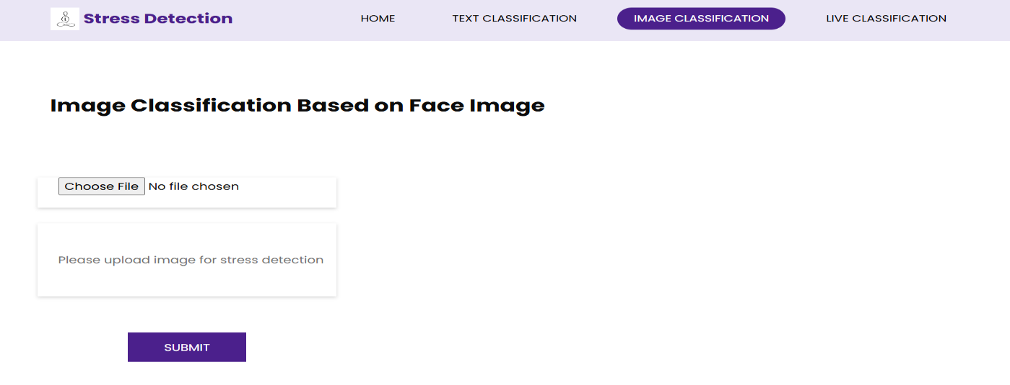
Results (Screenshots)

Slide 16
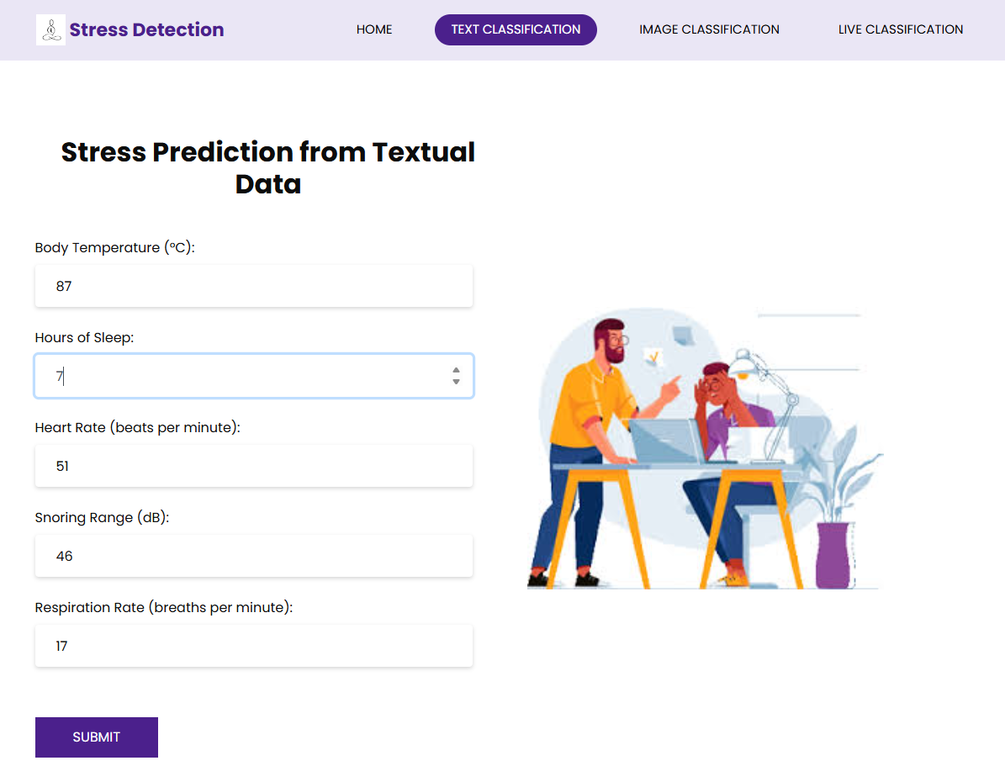
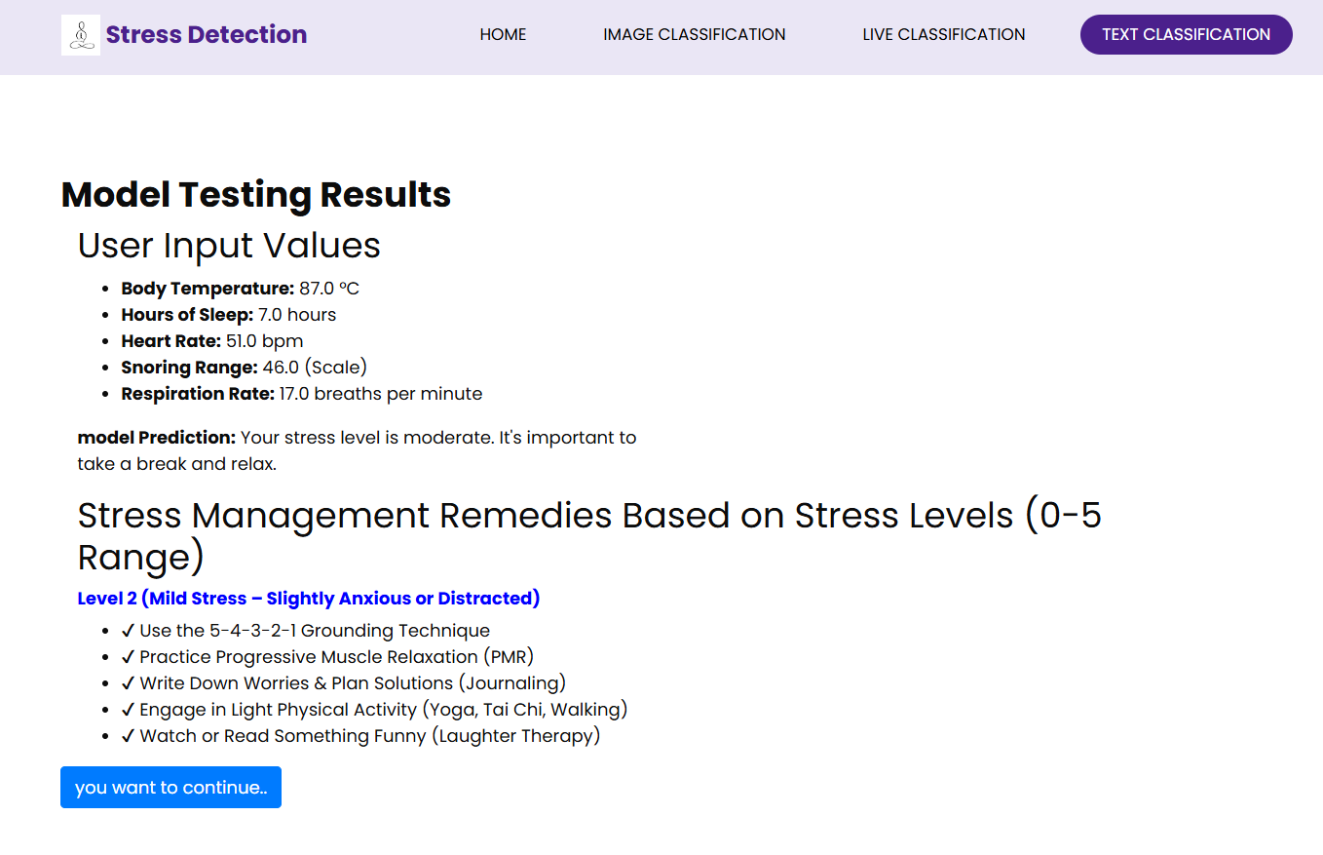

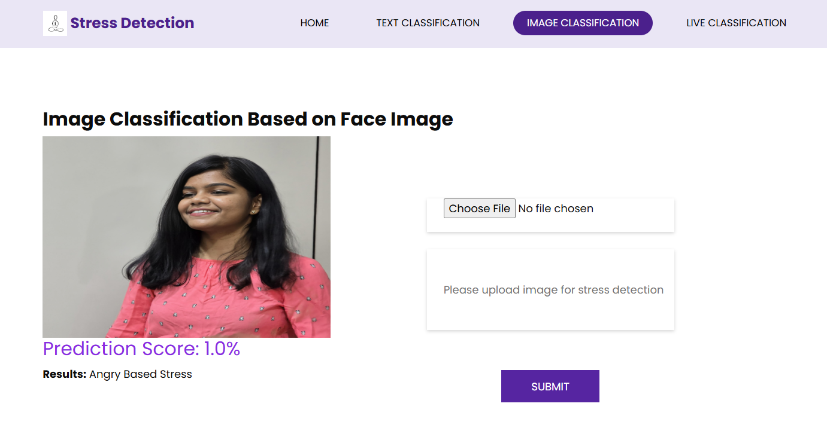
Cont..

Slide 17
Conclusion
The stress detection system using machine learning provides an effective and real-time approach to identifying and monitoring stress levels in students. By leveraging computer vision (OpenCV) and deep learning (DeepFace), the system can analyze facial expressions, physiological parameters, and behavioral patterns to detect stress levels.
Real-Time Monitoring – The system processes live webcam feeds and physiological data to assess stress levels instantly. Emotion-Based Stress Analysis – Facial expressions are classified into emotions like happiness, sadness, anger, and surprise, helping to determine stress levels. Physiological Feature Integration – Additional features like heart rate, sleep hours, and oxygen levels enhance prediction accuracy.

Slide 18
Reference
[1].Ravinder Ahuja and Alisha Banga, “Mental Stress detection in students”,Elsevier Ltd , vol. 11, pp. 349-353, Jan. 2019.
[2].Arsalan, Aamir, Syed Muhammad Anwar, and Muhammad Majid “Mental stress detection using data from wearable and non-wearable sensors: a review.”
[3] S. A. Singh, P. K. Gupta, M. Rajeshwari, and T. Janumala, ‘‘Detection of stress using biosensors,’’ Mater. Today, vol. 5, no. 10, pp. 21003–21010, 2018.
[4] J. Ogorevc, A. Podlesek, G. Geršak, and J. Drnovšek, ‘‘The effect of mental stress on psychophysiological parameters,’’ in Proc. IEEE Int. Symp. Med. Meas. Appl., Bari, Italy, May 2011, pp. 294–299

Slide 19
Github

Slide 20
Thank You!!!

